Slide 1
CSE 11 Accelerated Intro to Programming Lecture 5
Greg Miranda, Spring 2021
This lecture is being recorded

Slide 2
Announcements
Quiz 5 due Friday @ 8am
PA1 due tonight @ 11:59pm
Survey 2 due Friday @ 11:59pm

Slide 3
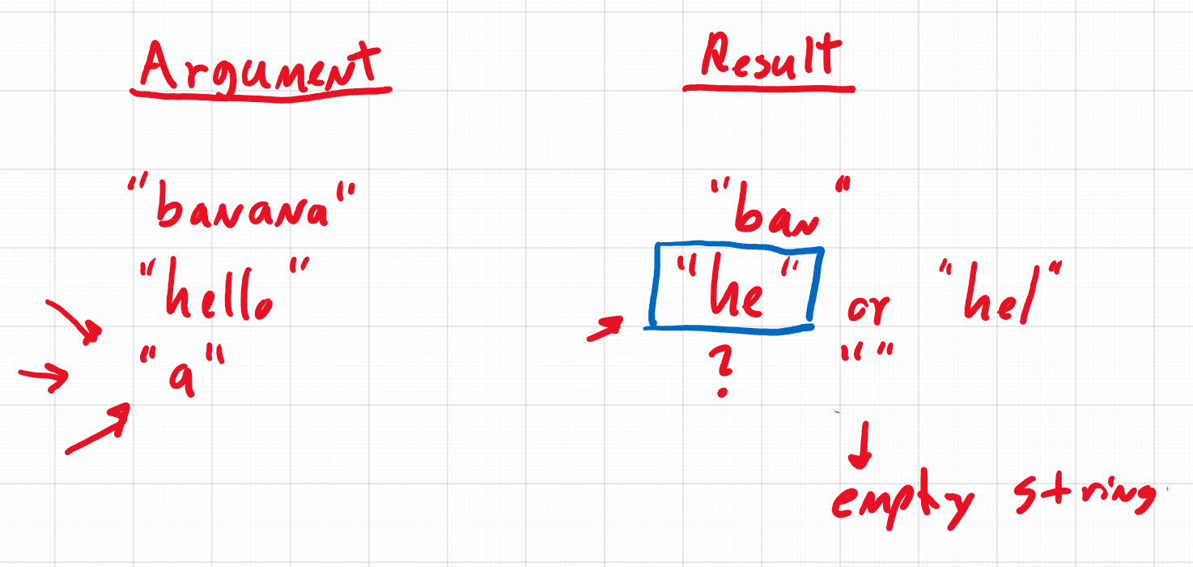

Slide 4

String example program
class StringExamples {
}
Write a method called firstHalf that:
Takes a String and returns a new String that has just the first half of the characters from the input String
When writing a method:
Think about what some examples are and what we expect the results to be:
We can write these down as fields
Then we can easily check if we are right after running the program
Examples first – then build up into the implementation
Do on paper/whiteboard first – then type them in

Slide 5
One of the first things to think about is:
What method (or methods) out of the methods we saw on strings is going to be useful here
We will be able to accomplish this only with methods we have seen so far

Slide 6
This showed us how to implement a method from a word problem prompt
We thought through some examples
Which helped us to refine our understanding
We experimented a little bit
Figured out we are okay with this empty String result
This is the process we should use when implementing methods
i.e. Programming Assignments

Slide 7

New Data Type
Previous data types:
String
int
Examples
boolean b1 = 4 < 5;
boolean b2 = 5 < 4;
New data type:
Boolean
Uses different kinds of operators
Comparison operators

Slide 8
String – many different types of strings, infinite # of strings
Only limited by how much memory is in our computer
int – somewhat limited
-2,147,483,648 to 2,147,483,647
Boolean – only two values
true / false
Represents the answers to yes or no questions
4 < 5
Asking the question: is 4 less than 5?

Slide 9
Many boolean operators
boolean b3 = 4 == 4; //checks for equality
boolean b4 = 4 == 5;
= is not the same as ==
= is used to create or initialize a field definition
Assignment operator
boolean b5 = 5 > 4;
boolean b6 = 5 >= 4;
As well as <=
All of these are ways to compare numbers
Gives true/false (yes or no) answers
What happens if we use it to compare Strings?
boolean stringComp = “a” < “b”;

Slide 10
Useful idea when learning a new feature
Ask if it works with other things you’ve worked with before
Comparison operators like < and > do not type check
Only numeric types work with Java’s type checking
What about == on Strings?
boolean stringComp = “a” == “a”;
== does produce an answer on Strings
boolean stringComp = “a” == “b”;
Does produce an answer, but not recommended for Strings
We will talk more about comparing Strings for equality in future weeks
Only use == for numeric comparisons in this course

Slide 11
Main lesson:
2 new values
true/false
With new data type boolean
New relational and comparison operators that work with booleans
< >
<= >=
==
Another comparison operator
!=
boolean b7 = 4 != 5;
boolean b8 = 5 != 5;
Opposite of the == answer

Slide 12
Boolean Operations
What can you do given a boolean?
What if we want to ask more than simple questions
Are two things true at the same time?
Is one of two things true?

Slide 13
Combining booleans into another boolean
boolean and1 = true && true;
boolean and2 = true && false;
boolean and3 = false && true;
boolean and4 = false && false;
boolean or1 = true || true;
boolean or2 = true || false;
boolean or3 = false || true;
boolean or4 = false || false;

Slide 14

Methods with Booleans
Number line 1
Problem:
Write a method that takes a number and returns true if it’s in the region in our number line example
Examples:

Slide 15

boolean numberLine2(int number) {
return (number > 5) && (number < 7) || (number < 2);
}
What does this number line look like?

Slide 16
More Complicated Questions with Methods
Write the method to calculate absolute value that takes a number and returns the negation if it’s less than 0, or that number otherwise
Examples:
int abs1 = this.absolute(-2); //should produce 2
int abs2 = this.absolute(4); //should produce 4

Slide 17

int absolute(int number) {
}
Important comparison we need to do here
Is the number less than 0?
number < 0
Don’t want to return true or false, we want to return the right number
New Java syntax:
if statement

Slide 18
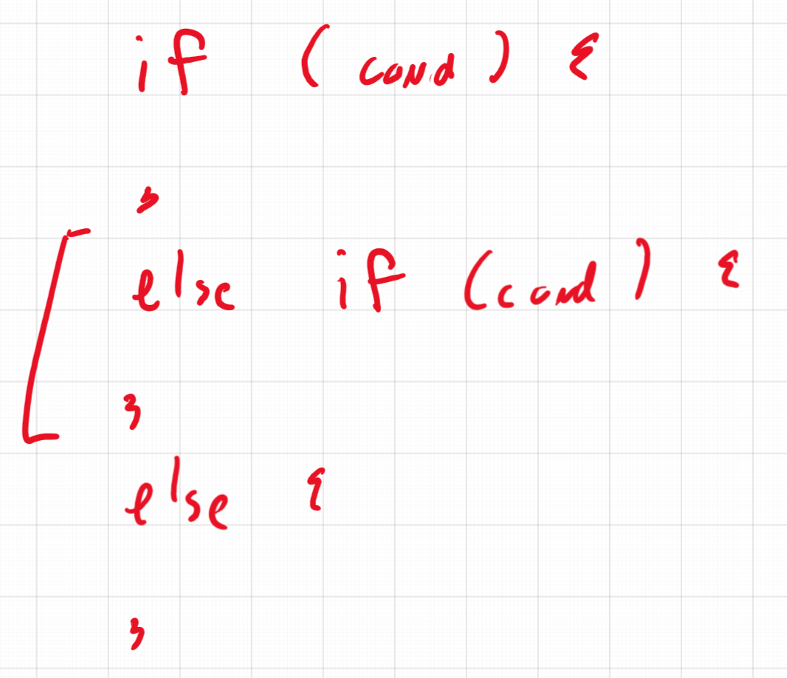

Slide 19
Weekly Pay Problem
weeklyPay: takes a number of hours worked and an hourly rate, and returns the pay with overtime (over 40 hours) counting as double the rate
Examples:

